Slide 1
Customer Support Data Analysis SQL Project
Meharan Shaikh Data Source: Kaggle

Slide 2
Introduction
Project Overview: Analyzed customer support data to understand performance and customer satisfaction.
Dataset Information: Data includes call details like agent, date, time, topic, and outcomes.

Slide 3
Questions to Answer:
How many calls did each agent take?
How many calls per day?
What were the most common topics?
What's the average talk time per agent?
How many calls were resolved?
What's the satisfaction rating for each agent and topic?
How quickly were calls answered?
When are the busiest hours?

Slide 4
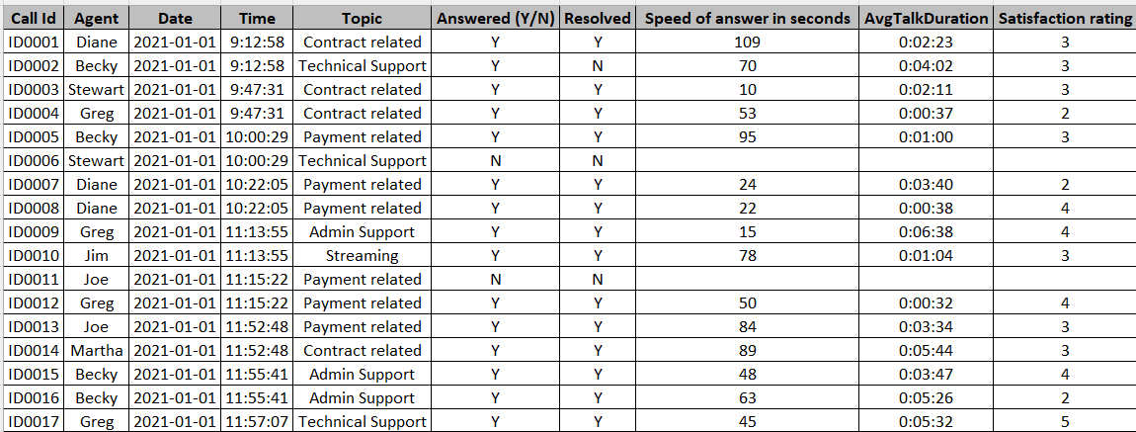
Dataset Overview
Description: The dataset covers the period from January 1, 2021, to March 31, 2021, and contains 5,001 records.
Sample Data: Here are a few rows from the dataset to illustrate its structure and content.

Slide 5
Methodology
Data Preparation: Cleaned and imported data into MySQL for analysis.
SQL Queries: Used SQL to calculate averages, counts, and other metrics.

Slide 6
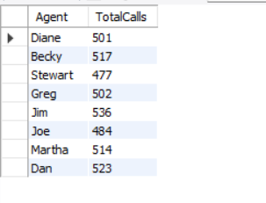
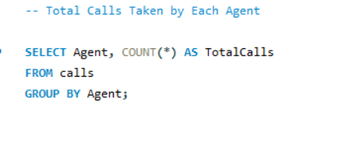
Question 1:

Slide 7
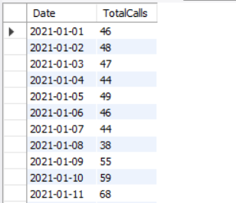
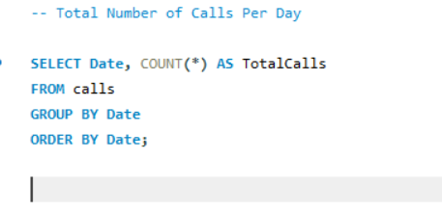
Question 2:

Slide 8
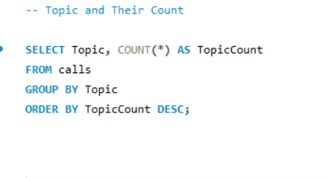
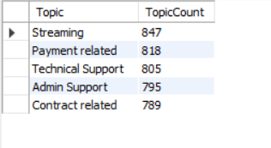
Question 3:

Slide 9
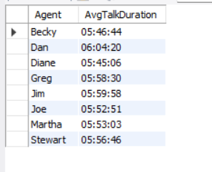
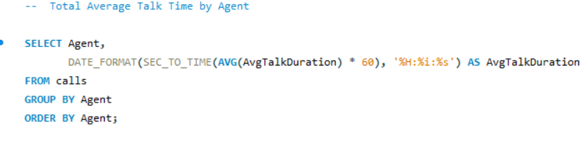
Question 4:

Slide 10
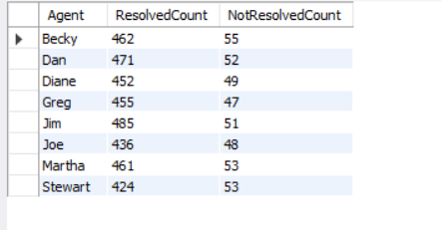
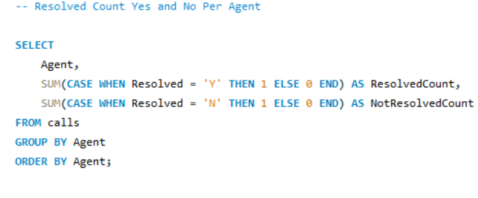
Question 5:

Slide 11
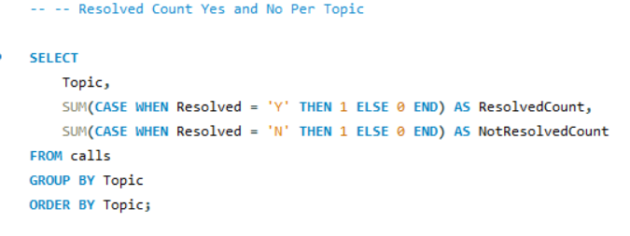
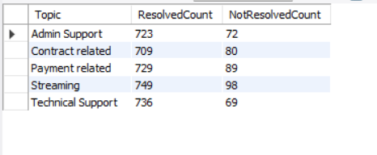
Question 6:

Slide 12
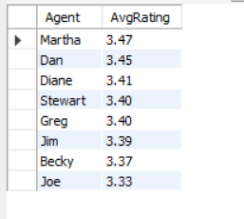
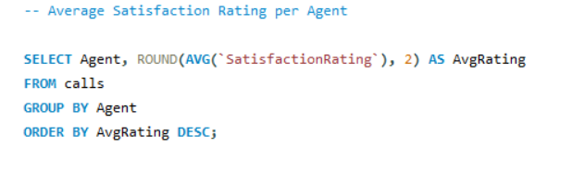
Question 7:

Slide 13
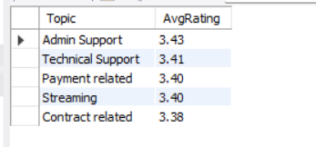
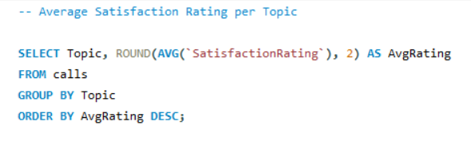
Question 8:

Slide 14
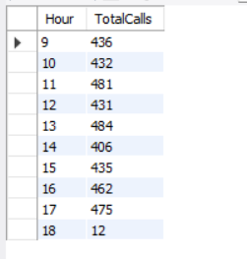
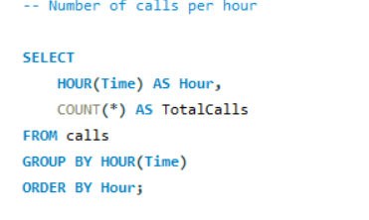
Question 9:

Slide 15
Conclusion:
The data analysis revealed variations in how agents handle calls and in the patterns of call activity. Some agents consistently resolved more calls, while others had longer talk times or lower satisfaction ratings
Based on these findings, we noticed that certain agents may need additional training to improve their performance. Additionally, there are specific times during the day when call volume is higher, indicating a need for more staff during these peak hours.

Slide 16
Recommendations:
Offer targeted training programs for agents with lower resolution rates to help them improve their skills and effectiveness.
Hire or schedule more staff during peak hours to reduce wait times and improve overall customer satisfaction.

Slide 17
THANK YOU!

